Slide 1

Exploring the Nature and Practice of Theological Formation
James Woodward
Principal
Sarum College

Slide 2

What does Formation mean for you ?

Slide 3
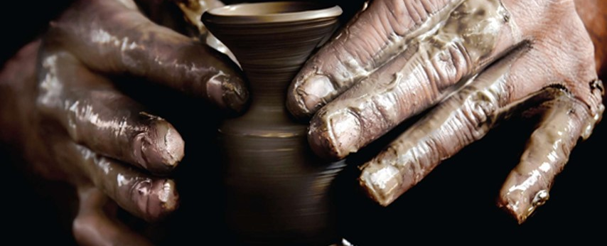
What is Formation?
Formation is the act of shaping, forming or fashioning.
As a potter takes a raw lump of clay dust and begins to mould it into a cup or pot, so we are being formed into the likeness of Christ.

Slide 4
And my most important theological question is …..

Slide 5
Some organising questions:
Why should I learn?
What should I learn?
How do I learn?
When do I learn?
Who are my co-learners?

Slide 6
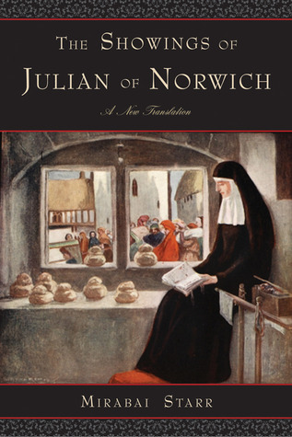
New Showings ?
God is not a static thing—not even a person—but a dynamic, pulsating activity, a life, almost a kind of drama. Almost, if you will not think me irreverent, a kind of dance.
Spiritual formation is for everyone. Just as there is an ‘outer you’ that is being formed and shaped all the time, like it or not, by accident or on purpose, so there is an ‘inner you.’ You have a spirit. And it’s constantly being shaped and tugged at: by what you hear and watch and say and read and think and experience. John Ortberg

Slide 7

Making Connections ?

Slide 8
Formation in Discipleship
Human Formation
Spiritual Formation
Intellectual Formation
Pastoral Formation

Slide 9


Slide 10

What might need to be nurtured in you?
1. Growing in inner freedom, so that we are is more able to give ourselves to the love and service of God and his people.
2. We strive to cultivate human qualities and virtues that enable us the student to be a bridge and not an obstacle for others in their meeting with Jesus Christ.

Slide 11

Spiritual Formation
Intellectual Formation
How do we live and learn together “to take on the likeness of Christ” The journey into God, has its beginnings in baptism, is life- long, shaped by the Holy Spirit.
Spiritual formation encourages us in a way of Christian living that involves interior discipline and self- sacrifice.
The spiritual life is, indeed, an interior life, a life of intimacy with God, a life of prayer and contemplation.
We aspire to grow in the knowledge and understanding of the faith that we professes and are called to proclaim.
If we are to prepare ourselves to be share our faith, we must also develop knowledge and understanding both of the human person to whom the Gospel is addressed and of the world or the culture in which it is to be preached and lived.

Slide 12


Slide 13
Who do we listen to ?
'ashamed of its past and uncertain of its future, the established Church lacks both authority and charm. It is, in short, a thoroughly mediocre product - and the truth about mediocre products is that you can advertise them as hard as you like but the punters still won't buy them’
Jane Shilling
Unfortunately, if theology doesn't listen to the constituencies that it serves, and if church people don't understand that they are massively out of touch with the secular thinking of people at large in our towns, cities and countryside, then they will remain as marginalised as those politicians who are widely perceived to be 'in it only for themselves’
Jeremy Paxman

Slide 14

Theology and new horizons of hope and possibility and transformation
Theology takes that view out into the world in a way that is accessible and liberative.
The best kind of theology listens and learns from what it hears and sees on the course of its travels.
It acknowledges the transcendent in the cinema, at the food counter and in shopping malls. It knows that God is a mystery, and cannot be circumscribed, prescribed, controlled, or limited to one location as distinct from another.
It knows that God is also a story, communicated within our own separate life stories and histories.

Slide 15

How to read the moment? 'we are all more complex, trickier and more wayward and human than any classification could ever reveal’ Miranda Sawyer
Have we struggled to respond in intelligible, sensitive language to this moment of pandemic?
How valid are the suspicions, fears and cynicisms of a generation that now question givens and the veracity and authority of the Establishment itself.
What are we to make of the prevalent conservatism of much of church life?
Is there a fundamental lack of strategic imagination about how to communicate effectively with those who are still concerned with the fundamentals that preoccupied Jesus.
#meaning #identity #status #corruption #hypocrisy #guilt #forgiveness

Slide 16

What can theology be and do ?
Theology can show us how to listen and hold the value of silence.
Such a theology will be empathic and open-minded and respectful.
Theology can recognise what it sees as sources of wisdom as invigorating and rejuvenating.
Theology knows that by itself, it does not have all the answers; a process of reciprocal exchange is necessary for Church and world to make sense to one another.

Slide 17

So why bother at all, then, with theology?
It is still able at its best to articulate that sense of the ineffable and essential which gives meaning, purpose and definition to our lives, both as individuals and as the social creatures who owe it to ourselves to look after one another and the planet that succours and shelters us.
It may yet point towards a context where human beings may be freer, more complete, and more fully apprised of the mystery which is at the heart of all mysteries, from which we emerge and to which in the end we return.
Theology will be the sensitive language of a Christian community that is outward-looking, self-effacing and non-dogmatic. It will begin from experience, conduct a process of exchange with the world
It will serve as the codex for a federation of fellow travellers on life's way. Those travellers are oriented towards their brothers and sisters in a spirit of hope and grace.

Slide 18

Don’t tell me…. Show me

